Slide 1
DATA1203 – Business Analysis and Assesments 1
Assignment - 4
Executive Dashboard
Presented by, Nishanth Maria Arul
100813350

Slide 2


Agenda
The Task
Data Cleaning
Data Analysis
Dashboard
Questions
Conclusion

Slide 3
The Task
The Senior management at The Coffee Cup has provided a dataset which contains the information from 2018 and 2019.
The task in hand is to analyze the data and provide much needed answers.
The dataset provided is ‘The Coffee Cup’ dataset.

Slide 4
Data Cleaning
Data Cleaning is the process in which the incorrect, wrong and repeated values are either deleted or filled with suitable values.
For cleaning the dataset, MS Excel is used.
The cells with null values were removed throughout the files and are either replaced with appropriate values like mean or they were simply deleted, provided it did not affect the dataset.
The format of the geographical data like cities and states were in string and were changed to geographical data.
Prince Edward Island, was not recognized as a geographical variable because, it was stored as PEI. So, it was deleted and changed to Prince Edward Island.
Moreover, the date was also stored as a string variable, which was changed to date.
New columns were added for adding new fields. The new columns added were inventory turnover, gross profit and GMROI.

Slide 5
Data Cleaning
Inventory turnover can be defined as the ratio of the sales to the average inventory.
It shows how many times the inventory is sold and refilled during a given period of time.
Gross Profit is the difference between the net profit and the cost of goods sold.
GMROI is the ratio of gross profit to the average inventory cost.
It is used to determine the amount of money to be invested in inventory for generating the gross margin dollars.

Slide 6
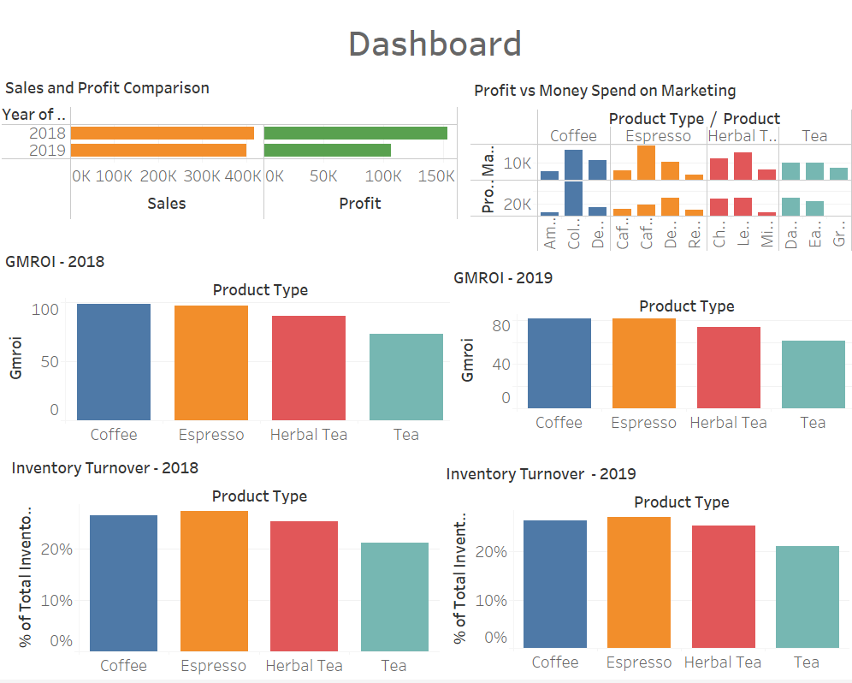
Dashboard

Slide 7
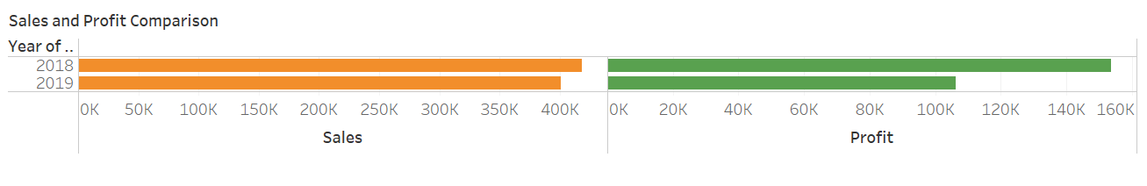
Data Analysis
Visualization 1: Sales and Profit Comparison
In this visualization, the sales and profit for the years 2018 and 2019 are compared.
Of the two years, the year 2018 was profitable.
This shows that there is a decline in sales and profit in 2019.

Slide 8
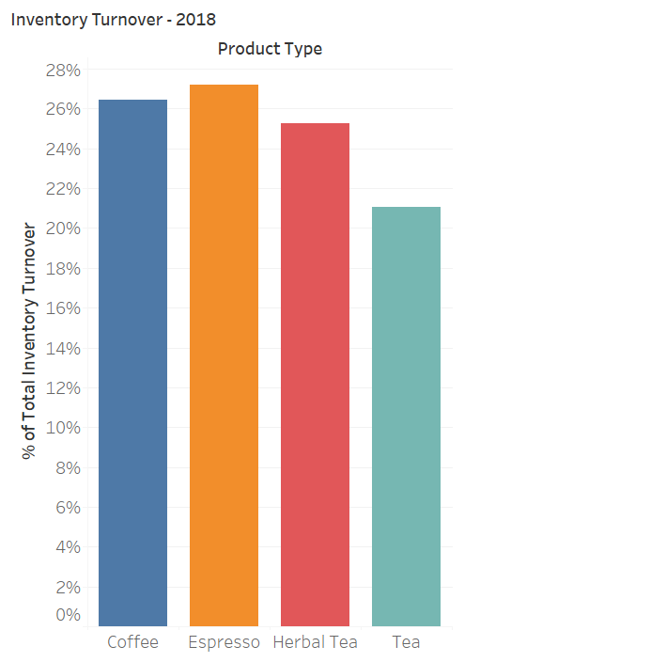
Data Analysis Visualization 2: Inventory Turnover – 2018
Here, we have plotted inventory turnover ratio against product type for the year 2018.
This shows that Espresso has the highest inventory turnover ratio with 27.2% and Tea has the lowest inventory turnover ratio with 21.1%.
This shows that Espresso is the fast-moving product whereas Tea is the least moving product.

Slide 9
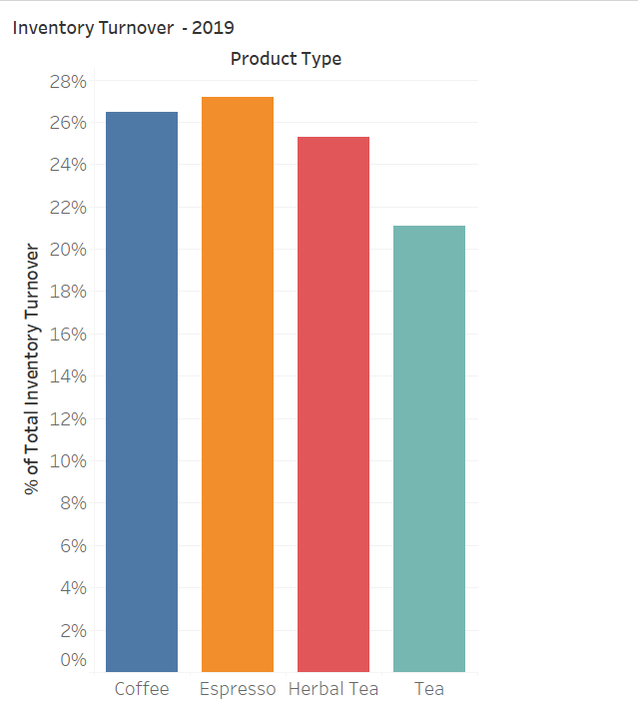
Data Analysis Visualization 3: Inventory Turnover – 2019
Here, we have plotted inventory turnover ratio against product type for the year 2019.
Espresso has the highest inventory turnover ratio with 27.1% and Tea has the lowest inventory turnover ratio with 21.1%.
This shows that Espresso is the fast-moving product whereas Tea is the least moving product.

Slide 10
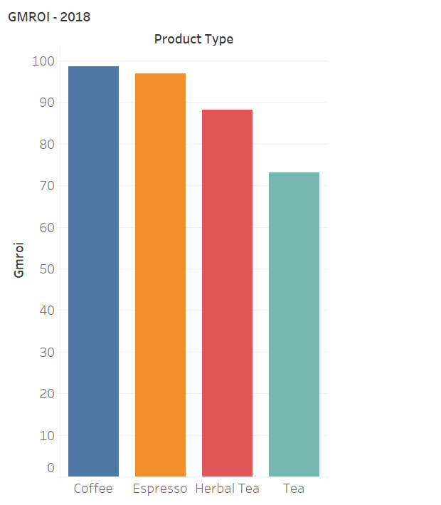
Data Analysis Visualization 4: GMROI – 2018
In this case, we have plotted the product type against GMROI for the year 2018.
This shows that coffee has the highest GMROI with 98.64 and Tea has the lowest inventory turnover ratio with 72.
This shows that coffee produces higher return on investment than any other product whereas Tea produces the least.

Slide 11
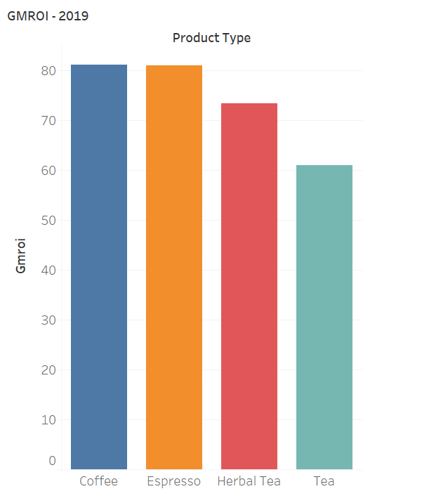
Data Analysis Visualization 5: GMROI – 2019
In this case, we have plotted the product type against GMROI for the year 2019.
This shows that coffee has the highest GMROI with 81.12 and Tea has the lowest inventory turnover ratio with 60.9.
This shows that coffee produces higher return on investment than any other product whereas Tea produces the least.

Slide 12
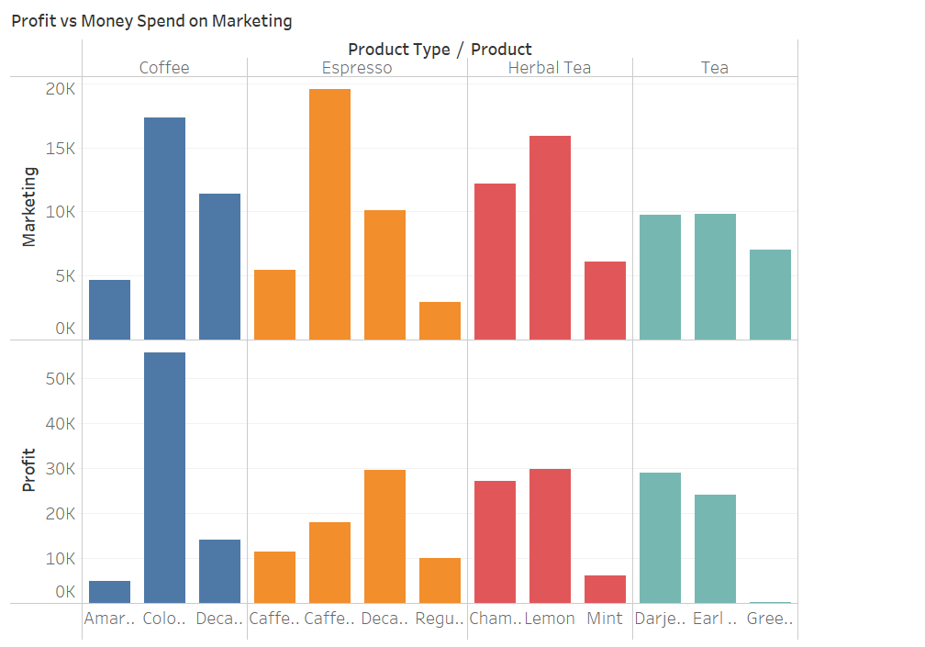
Data Analysis Visualization 6: Profit vs Marketing
In the first graph, the products are compared with the money spent on marketing.
In the second graph, the profit generated by the products are plotted.
Both charts can be compared with each other to find out if the money is worth spending on marketing.
Here, huge money is spent on espresso and coffee for marketing, and they bring in returns. At the same time, the profit generated by green tea is too low and is so less when compared to the amount spent on marketing.

Slide 13
Questions
Do sales depend on size of the market?
Is the business growing?
Has spending in marketing paid off for each product?
Which product can be discontinued?
Which province has the highest sale?
Which market leads in sale?
Which product is the most sought out?
Has the company generated higher profit in 2019 than 2018?

Slide 14
Conclusion
After comparing 2018 and 2019, it could be seen that the sales is lesser in 2019. The margin is around $10,000.
But the profit margin between these two years is around $50,000, which shows that there is a rise in expenses.
The inventory turnover and GMROI are good.
Even though more money is spent on marketing for certain products, the returns are less which begs the question if the company should sell that product anymore.

Slide 15
Reference
Fernando, J. ( 2022, June , 27). Inventory Turnover. Retrieved from investopedia: https://www.google.com/url?sa=t&rct=j&q=&esrc=s&source=web&cd=&cad=rja&uact=8&ved=2ahUKEwi78rzn3br5AhWblIkEHf_dAhAQFnoECBcQAQ&url=https%3A%2F%2Fwww.investopedia.com%2Fterms%2Fi%2Finventoryturnover.asp&usg=AOvVaw1rvoNRGlSLb8bD4KcAHz0W
Hayes, A. ( 2022, July, 25). Gross Profit. Retrieved from investopedia: https://www.investopedia.com/terms/g/grossprofit.asp
Jenkins, A. ( 2022, August , 9). Inventory Turnover Ratio Defined: Formula, Tips, & Examples. Retrieved from Oracle netsuite: https://www.netsuite.com/portal/resource/articles/inventory-management/inventory-turnover-ratio.shtml
Kenton, W. ( 2021, March 30,). What Is the Gross Margin Return on Investment (GMROI)? . Retrieved from investopedia: https://www.investopedia.com/terms/g/gmroi.asp
Mascolo, F. ( 2020, Jun , 28). Exploring a Retail Data Set as an Investor. Retrieved from towardsdatascience: https://towardsdatascience.com/exploring-a-retail-data-set-as-an-investor-1b08e5c7b255
Rivera, M. P. (n.d.). What is a strategy map (& do you need one)? Retrieved from clearpoint strategy: https://www.clearpointstrategy.com/what-is-a-strategy-map/
Tableau. (2022). Guide To Data Cleaning: Definition, Benefits, Components, And How To Clean Your Data. Retrieved from tableau.com: https://www.tableau.com/learn/articles/what-is-data-cleaning

